Slide 1
Introduction to C++ programming
Md. Kamrul Islam
Lecturer, Dept. of CSE, RMU

Slide 2
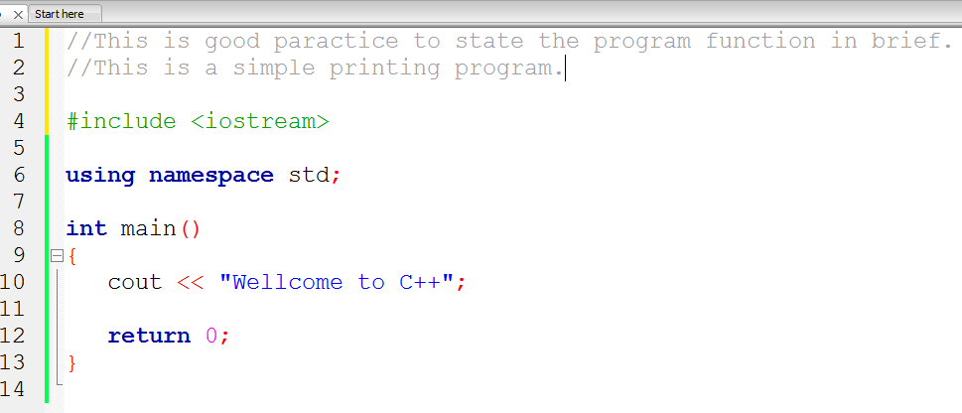
Basic Structure of C++ Program

Slide 3
Variables
A variable provides us with named storage that our programs can manipulate.
A variable is a data name that may be used to store data value.
In C we had to declare all variables at the top of the block.
But in C++ we can declare any variable any where in the program.
Variable Definition in C++:
type variable_list;

Slide 4
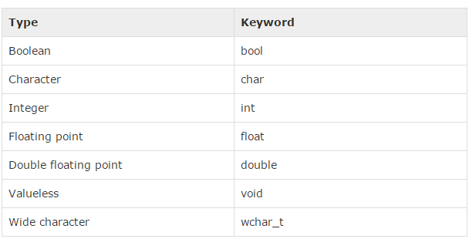
Data Types
C++ offer the programmer a rich set of built-in as well as user defined data types. Following table lists down seven basic C++ data types:

Slide 5
Write a program that will print the summation of two integer numbers

Slide 6
Constants
Constants refer to fixed values that the program may not alter and they are called literals.
Constants can be of any of the basic data types and can be divided into Integer Numerals, Floating-Point Numerals, Characters, Strings and Boolean Values.
Constant Declaration:
The #define Preprocessor:
The const Keyword:
const type variable = value; const int a=10;
#define identifier value #define a 10

Slide 7
Self Test!
Problem
Write a complete program that calculates and displays the product of three integers. Add comments to the code where appropriate.

Slide 8
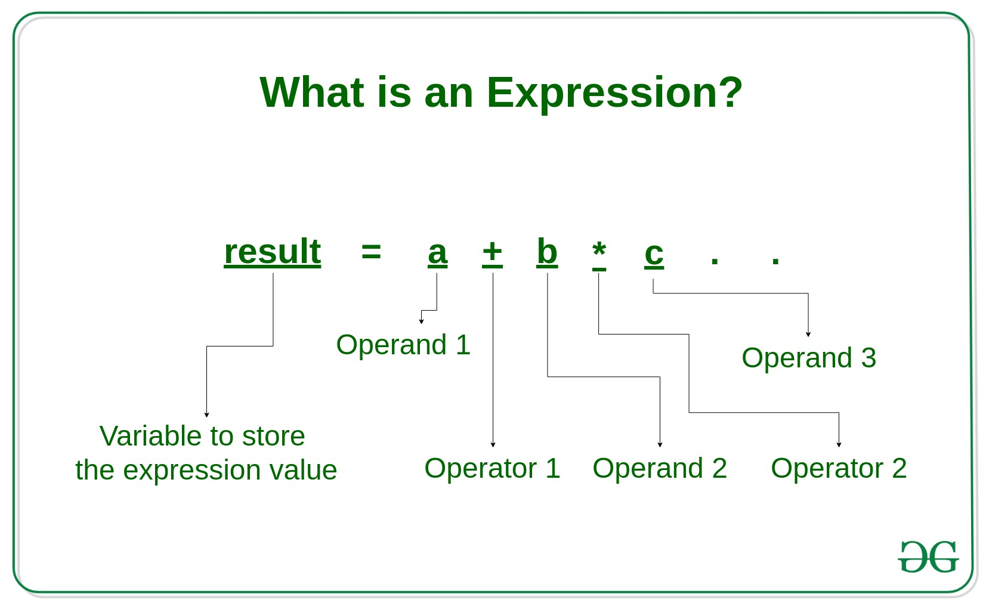
Expression
An expression is a combination of operators, constants and variables. An expression may consist of one or more operands, and zero or more operators to produce a value.

Slide 9
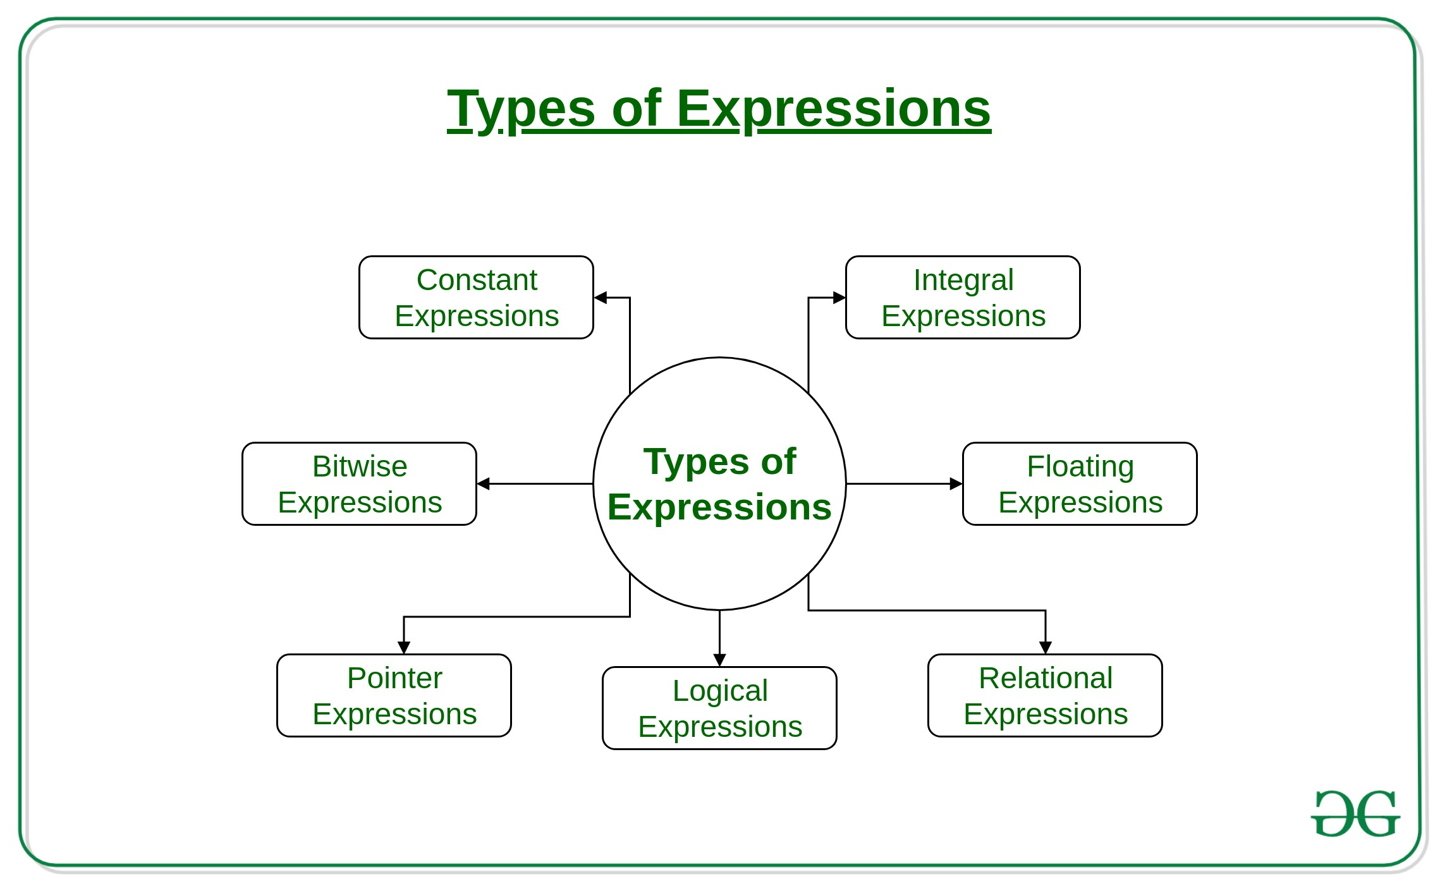
Types of Expression

Slide 10
Statement
A statement causes the computer to carry out some definite action.
Example:
a = 6;
c = a + b;
++j;

Slide 11
Operator
An operator is a symbol that tells the compiler to perform specific mathematical or logical manipulations.
C++ is rich in built-in operators and provides the following types of operators:
1.Arithmetic Operators
2.Relational Operators
3.Logical Operators
4.Bitwise Operators
5.Assignment Operators
6.Misc Operators

Slide 12
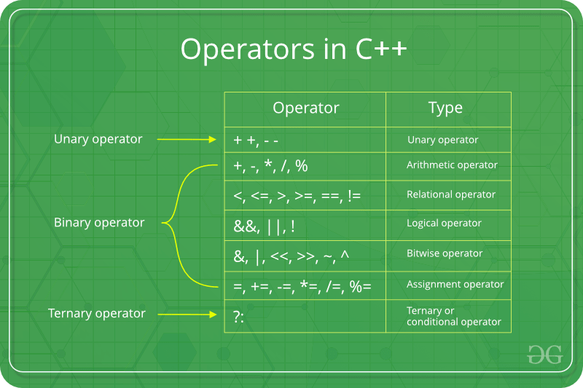
Operator

